Slide 1
Financial Crime Analysis

Slide 2
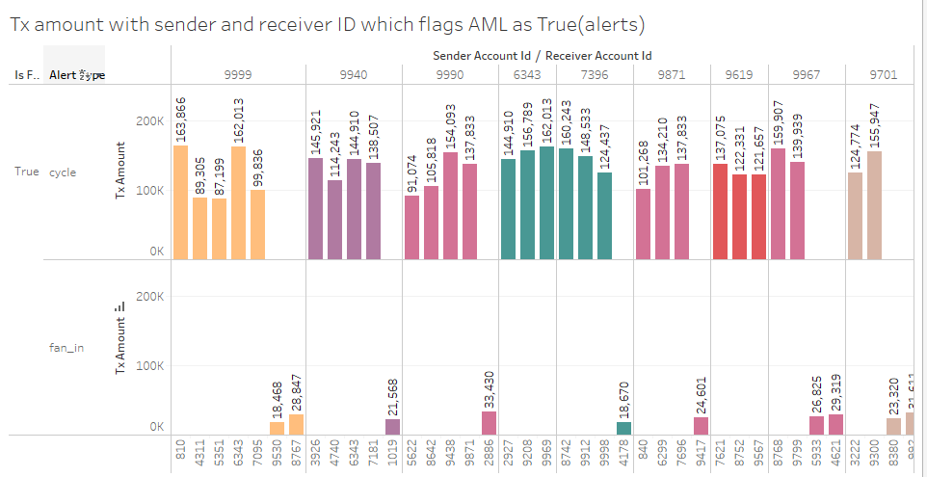
Tx Amount (AML)
In this plot all the sender ID which are 9999 9940 9990 6343 7396 9871 9619 9967 have the large amount of transactions to various different receiver id’s this could indicate money laundering signs as transactions a re happening from One id to many other different ID. Amounts are distributed in two types of rows which indicate AML flag type i.e Cycle and fan_in. Same analysis is done for other ids also which are mentioned in the form of screenshots.

Slide 3
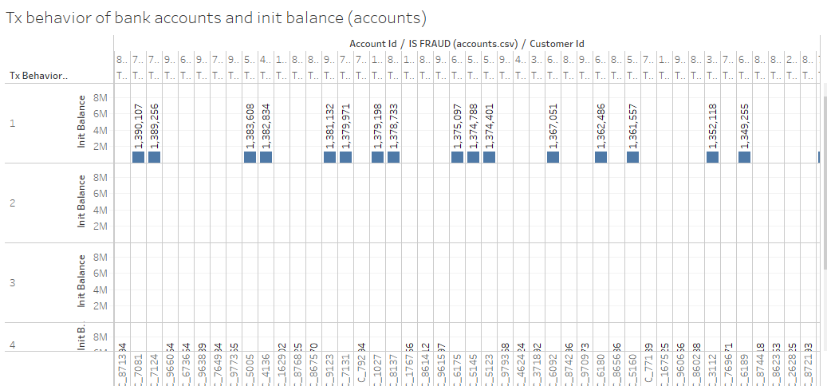
Tx Behaviour 1 of bank account
This plot shows the account id of banks with init balance for Tx Behavior id 1. The balance in this plot of all the Account ID is between 1 to 2 million. These banks in the plot are the banks which shows the Fraud Flag. Large amounts of banks are recorded in the plot, the same is given in the screenshots provided.

Slide 4
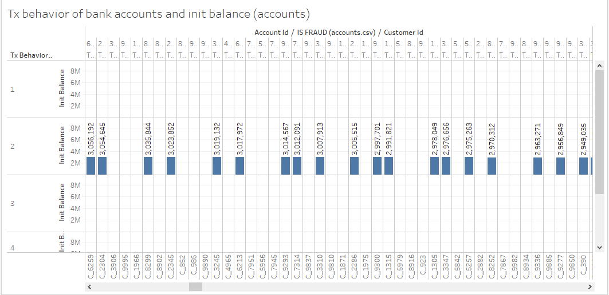
Tx behaviour 2 of bank accounts(init balance)
This plot shows the account id, init balance for Tx Bhevior id 2. The balance in this plot of all the Account ID is between 3 to 4 million. These banks in the plot are the banks which shows the Fraud Flag. Large amounts of banks are recorded in the plot, the same is given in the screenshots provided.

Slide 5
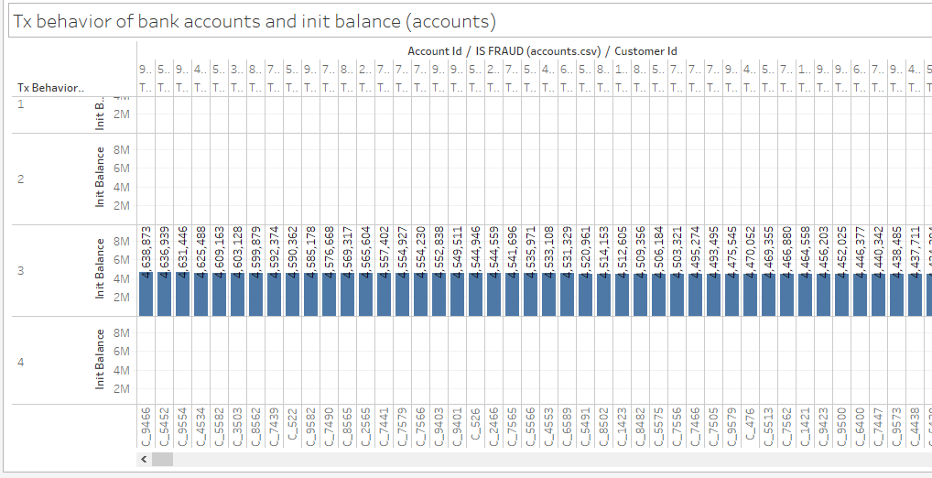
Tx behaviour 3 of bank accounts(init balance)
This plot shows the account id of banks with init balance for Tx Behavior id 3. The balance in this plot of all the Account ID is between 4 to 5 million. Banks with Tx Behavior id 3 has the highest amount of init balance. These banks in the plot are the banks which shows the Fraud Flag. Large amounts of banks are recorded in the plot, the same is given in the screenshots provided.

Slide 6
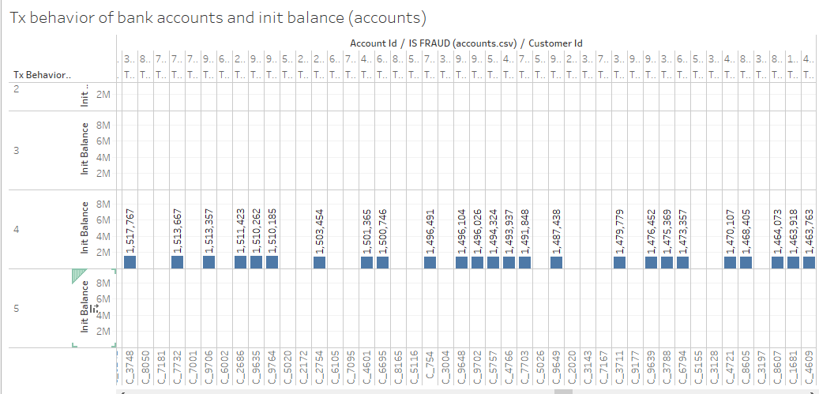
Tx behaviour 4 of bank accounts(init balance)
This plot shows the account id of banks with init balance for Tx Behavior id 4. The balance in this plot of all the Account ID is between 1 to 2 million. These banks in the plot are the banks which shows the Fraud Flag. Large amounts of banks are recorded in the plot, the same is given in the screenshots provided.

Slide 7
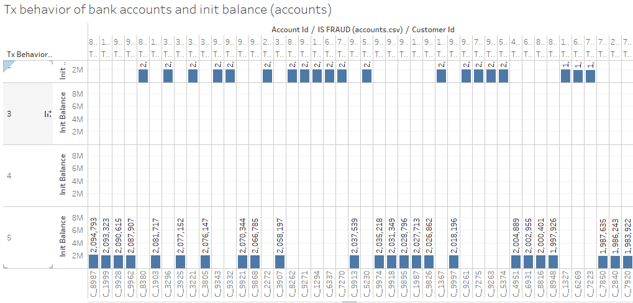
Tx behaviour 5 of bank accounts(init balance)
This plot shows the account id of banks with init balance for Tx Behavior id 5. The balance in this plot of all the Account ID is between 2 to 3 million. These banks in the plot are the banks which shows the Fraud Flag. Large amounts of banks are recorded in the plot, the same is given in the screenshots provided.

Slide 8
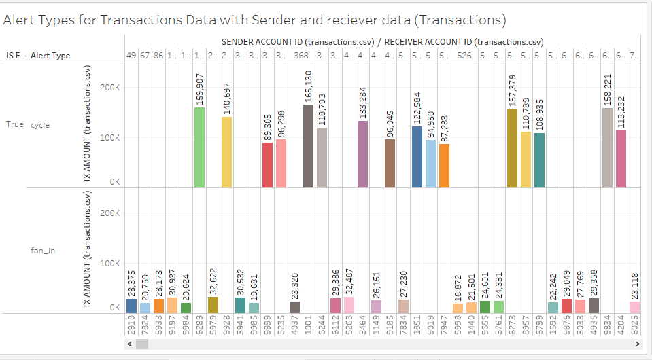
Alert Types for Transactions Data (Sender and Receiver)
This plot shows the amount of transactions between sender and receiver accounts. Also this plot shows the alert types Cycle and fan_in. Transactions with the alert type fan_in has less amount of transaction amount as compared to Cycle.

Slide 9
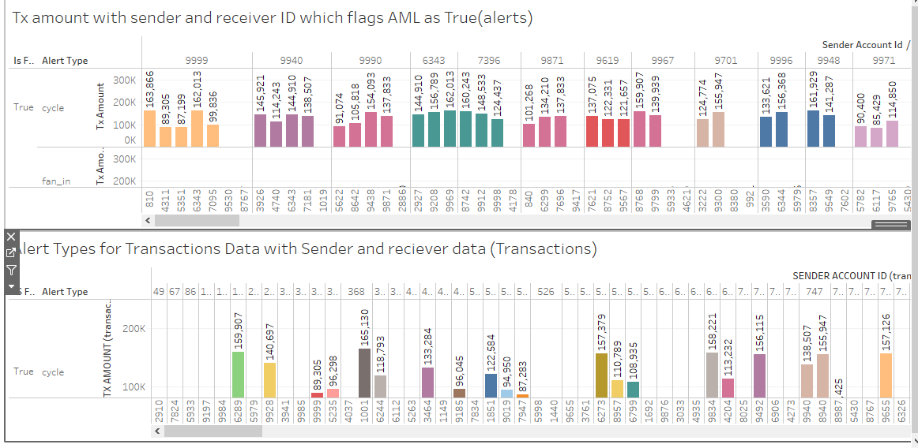
DASHBOARD

Slide 10
Money Laundering Transaction Network Structures
E-banks have to fulfill a crucial role, since money laundering is seen as one of the main problems to continue with a reliable international financial system.
It damages the legal world economy since the money is earned illegally, prevention of money laundering brings high investigation costs due to the detection monitoring systems, and it promotes weak detection policies considering weaker policies are more attractive and accessible to launder money.
Eventually, financial markets could become unstable, and ultimately, it could affect economic growth.
Additionally, money laundering is often used as a gateway to finance terroristic activities, hurting our society financially and politically.
According to the International Monetary Fund (IMF), the size of money laundering worldwide is approximately five percent of the global gross domestic product (GDP), similar to 3,000 billion US dollars.

Slide 11
Activities which indicates of Money laundering
The funneling of cash or other funds generated from illegal activities through legitimate financial institutions and business to conceal the source of funds.
These activities could indicate anything related to account openings, large each's sums, deposits , withdrawals, payments and wire transfers.
In our data we have the data of transactions form of sender ID and Receiver ID.
Money laundering can be divided into three layers which are placement, layering and integration phase.

Slide 12
Layering methods used in Money laundering
Layering methods used are:
circulating money between multiple financial accounts, shifting the money among many different entities, or by reselling assets - bought in the placement phase - locally or abroad.
The third and last phase is integration.
The illegally obtained money is converted to apparently legitimate business revenues through normal financial operations.
This operation is also done by dealing with properties and creating false loans.

Slide 13
Methods to Detect Money laundering
Two situations can occur when an alert is generated:-
when monitoring is done beforehand, for instance, in situations when a client wants to deposit high amounts of cash or change high amounts of currencies.
The second situation to generate an alert beforehand is done with the creation of a comprehensive client profile, including the transaction profile of clients containing the expected transaction behavior of the client.
Once the client wants to transfer money outside of this client profile, the transaction can be detected in advance. A transaction profile should be actual, complete, specific, organized, substantiated.

Slide 14
Machine Learning Methods which cnae be used for Detecting money Laundering
Machine Learning Methods which cnae be used for Detecting money Laundering
Decision Trees:-
Decision Trees are useful to generate anti-money laundering rules from customer profiles. A predictive method of Decision Trees is provided by Liu, Qian, Mao, & Zhu (2011) to discover money laundering patterns and rules. It states to identify suspicious transactions more effectively than rule-based methods.
Support Vector Machines:-
Tang & Yin (2005) propose a SVM method to detect suspicious transactions and recognize money laundering patterns. It is argued that the proposed SVM model could replace the rule-based method of transaction monitoring, surmounting problems such as processing large amounts of data. To find the optimal parameters, a cross-validation method is performed based on the highest accuracy rate. This avoids the problem of overfitting and under fitting, improving the classifier and its performance.
Neural Networks:-
Neural Networks could improve the reduction of false-positive rate, enhances the recall score, and adapts to changing risks and means of money laundering. This complication is a disadvantage for real-world practices, according to ING, since investigators also value the interpretability of money laundering patterns (ING, 2020). A consideration has to be made between the accuracy of correctly predicting money laundering transactions compared to the interpretability of these detected transactions.

Slide 15
Conclusion
Automation of the detection process is essential since financial institutions have to monitor high volumes of transactions on daily basis.
Machine learning techniques are very advantageous, detecting money laundering transactions and patterns for AML Flag.
Due to the constant invention of new methods to launder money, supervised and unsupervised methods are powerful techniques to detect new money laundering typology.
New development and testing of machine learning models are useful to improve the accuracy, recall and precision of detection methods.
In short in future machine learning model will be used for the prediction of AML flags.

